Slide 1

The Pathway to Progress
Transforming dependency into agency

Slide 2
Our Community
Provides grounding to individuals overwhelmed and frustrated in their efforts to fine meaningful purposeful employment.
Fosters hope and empowers agency
Develops Confidence in knowledge, skills , abilities and opportunities
Creates connections for social interaction with likeminded individuals
Employs training and practice to reinforce career development

Slide 3

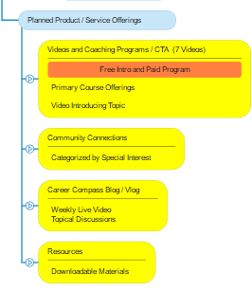
Pathfinders Campus
Practical training
Community
Inspiration
Resource Library

Slide 4
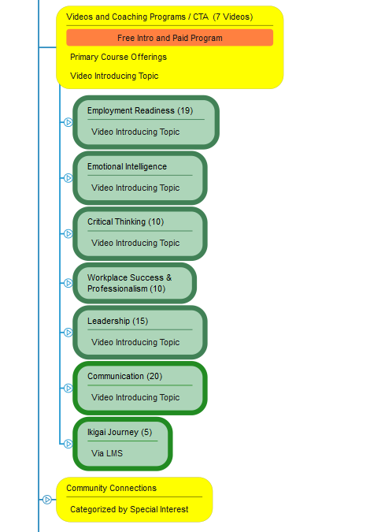
Career Development Training
Employment Readiness
Emotional Intelligence
Critical Thinking
Workplace Success
Leadership Skills
Communication
Ikigai

Slide 5
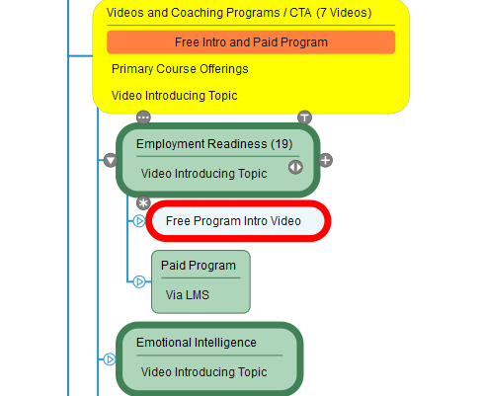
Video Coaching Programs
Various career development skills
Free program to introduce series
Paid Program for Extended Development

Slide 6
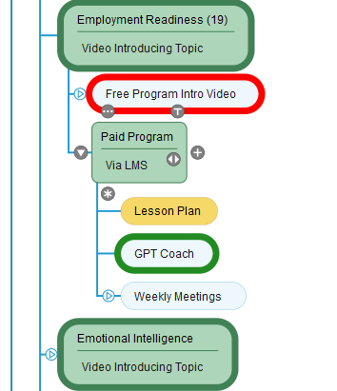
Paid Programs
Delivered Via Pathfinders LMS
Led by a partner with lesson plan
Include GPT Coach for practice
Weekly meetings cover skills

Slide 7
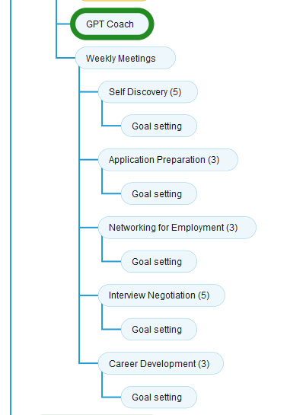
Weekly Meetings
Group sessions focus on specific skill development
  Topics vary depending on area
Facilitates Discussion and Goal Setting
Encourage Accountability

Slide 8
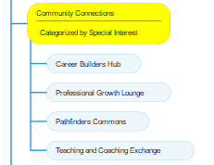
Exploring Connections
Career Builders Hub
  Students / Adults in Transition
    Finding Purpose
    Setting direction
Professional Growth
  Professionals Ready for the next level
Pathfinders Commons
  Networking
Teaching and Coaching Exchange
  Bringing skills and abilities to others

Slide 9
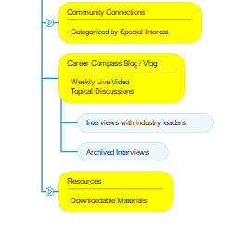
Inspiration
Interviews with:
Pathfinders Campus Leaders
Industry Professionals
Alumni

Slide 10
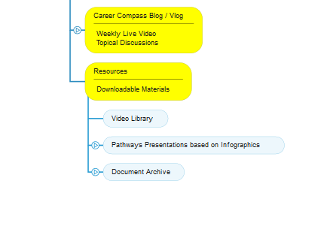
Access to Library of Resources
Video Library
Pathways Presentations
Documents
Step-by-Step GPT Prompts

Slide 11
Pathfinders Campus
Provides a framework for services
Encourages followers/subscribers
Develops Community
Facilitates Analytics
Facilitates Customer Relationship Management
Helps monetize our efforts

